Slide 1



UGC End-Of Year Banquet
Presented By:
DEBALEENA SAHA
DONG YU
NEHA TELAGUBANAJIGARA JAGANNATH
PRANAVANSHU VADREVU
RIKDEV BHATTACHARYA

Slide 2

AGENDA
About
Objectives
Major Achievements
Future Roadmap
Questions and Answers

Slide 3
About ConnectiKids
ConnectiKids is a private nonprofit agency in Hartford since 1978 stemmed from West Middle School Committee.
Their Mission
“Inspiring Hartford’s children to make positive choices, embrace high expectations and fulfill their potential by providing successful mentors, individualized tutoring, enriching activities and stimulating environments.”
Associations
Work directly with two elementary schools, West Middle Community and Michael D Fox, with students in kindergarten through eighth grade and serving hundreds of Hartford’s children annually now.
Their work
Provide one on one tutoring and mentoring, arts and enrichment and a character development program throughout the academic year as well as a summer program.
Expose students to new people, places, and experiences that promotes positive growth and development.
Areas to focus on
Increase Program Awareness
Increase Mentor Participation

Slide 4

OBJECTIVE
Increase participation of mentors
Social media campaigning
Revamp the website

Slide 5

RECCOMENDATIONS
Focused group marketing – identified the age group issue
Improve the user experience on the website
Concentrate on different touchpoints
Conventional – Flyers, bookmarks, email templates
Pull Marketing – Social media – Instagram, Facebook

Slide 6


BOOKMARKS

Slide 7

FLYERS AND EMAIL TEMPLATES

Slide 8

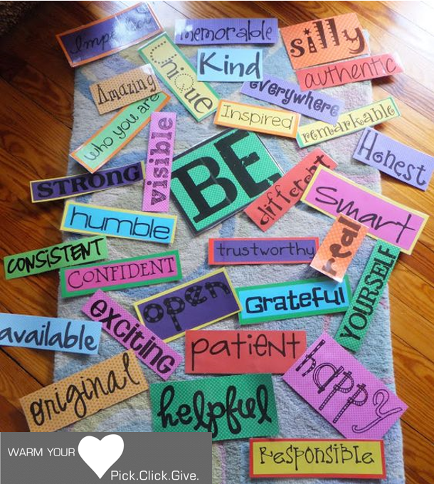
WALL OF MONEY

Slide 9
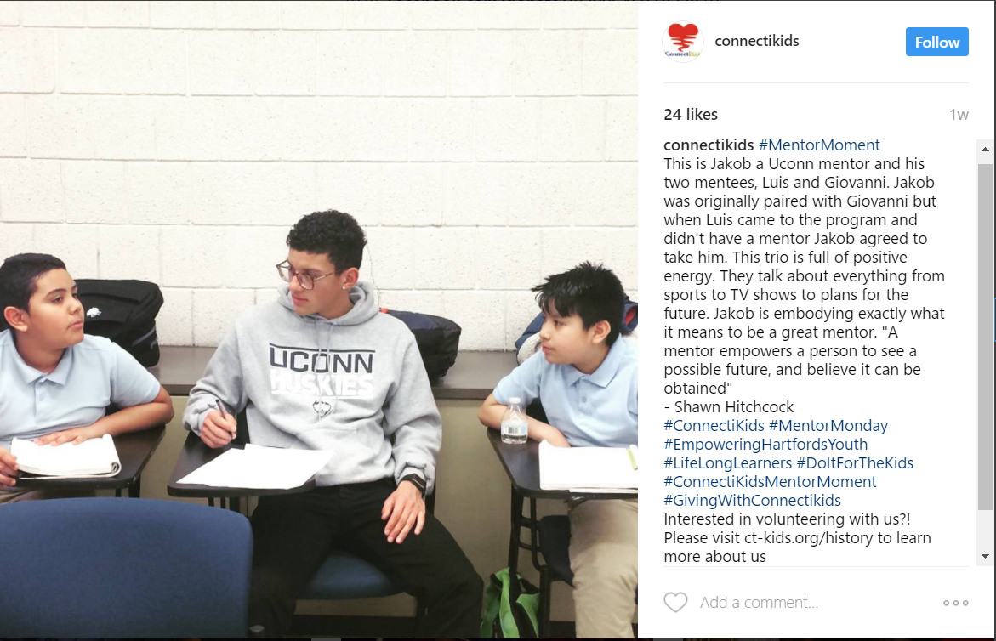
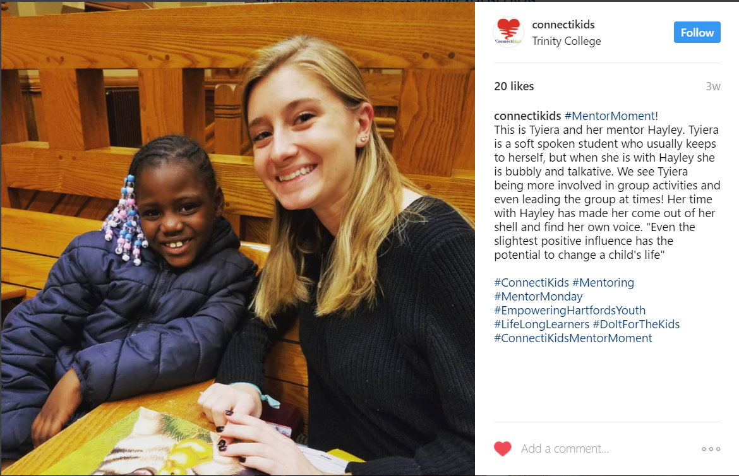

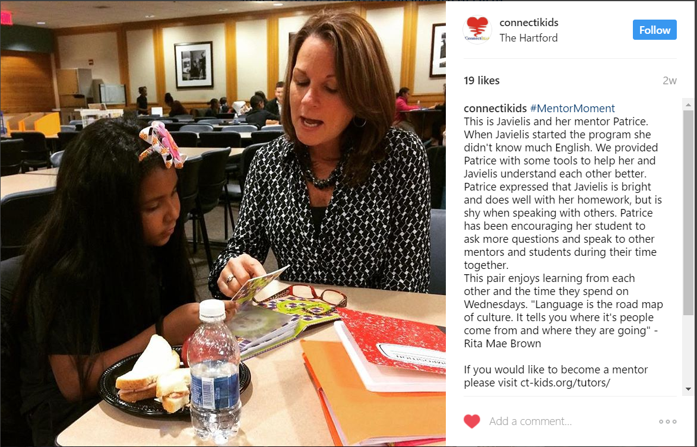
INSTAGRAM STORIES

Slide 10
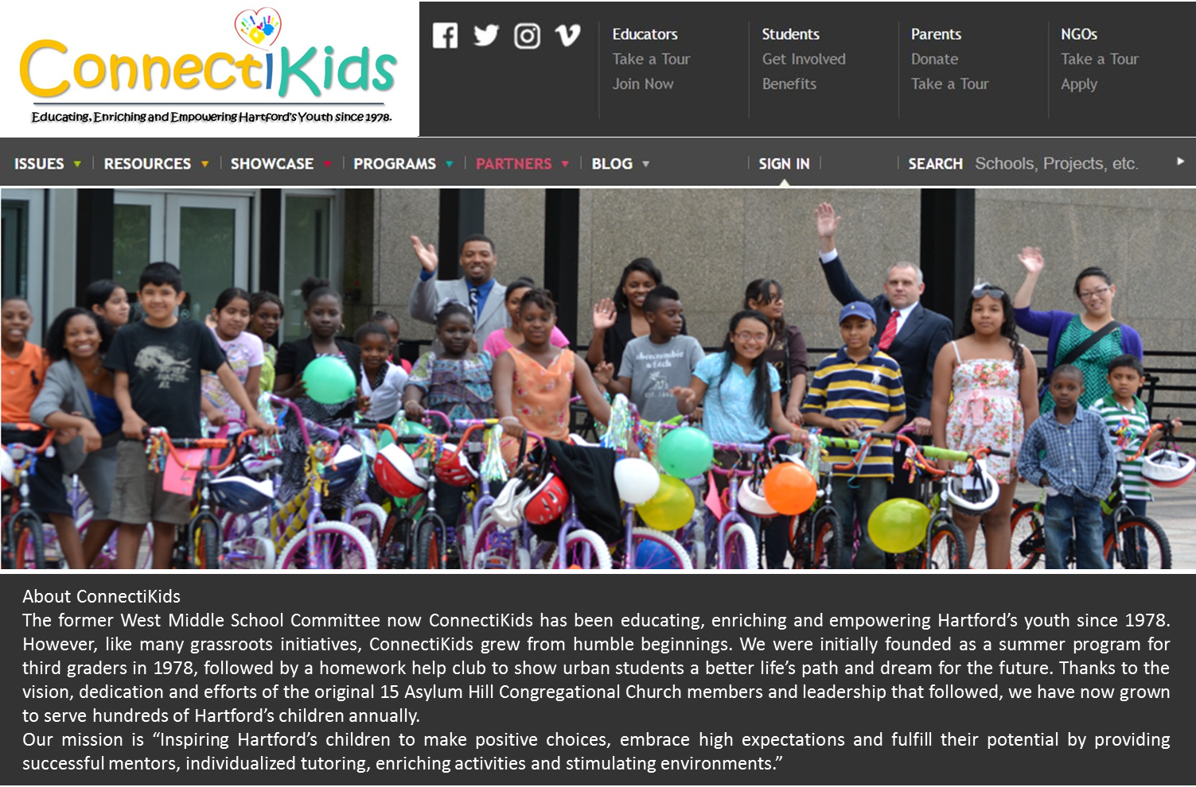
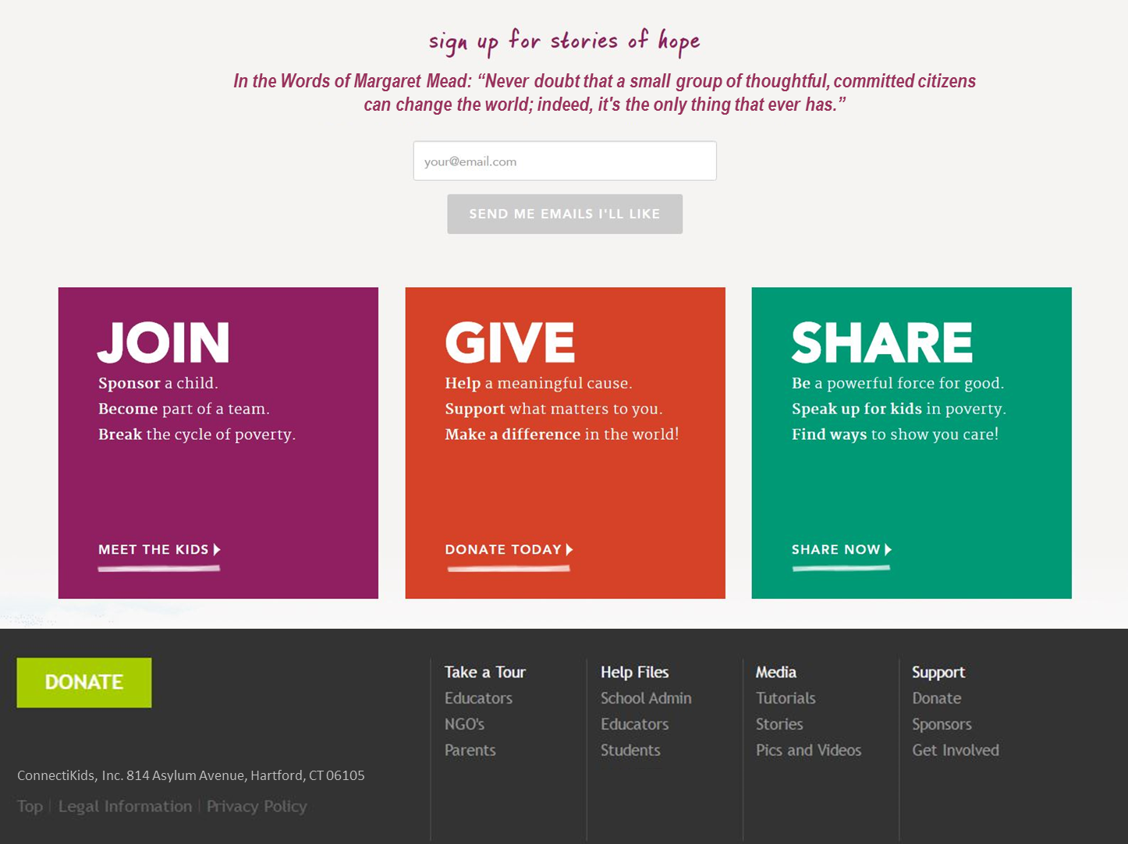
REVAMPED WEBSITE PROTOTYPE

Slide 11
RESULTS
Mentor Enrollment
Number of mentors at Trinity Past and Present
Last year:48 Mentors
This Year: 65 Mentors
35% increase in mentor enrollment, possibly more to come
Social Media Statistics

Slide 12
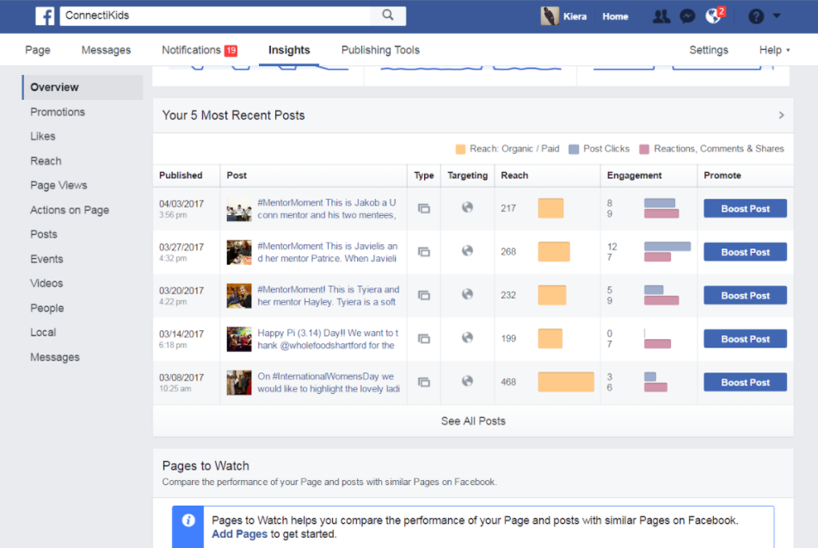

SOCIAL MEDIA OUTREACH-FACEBOOK

Slide 13
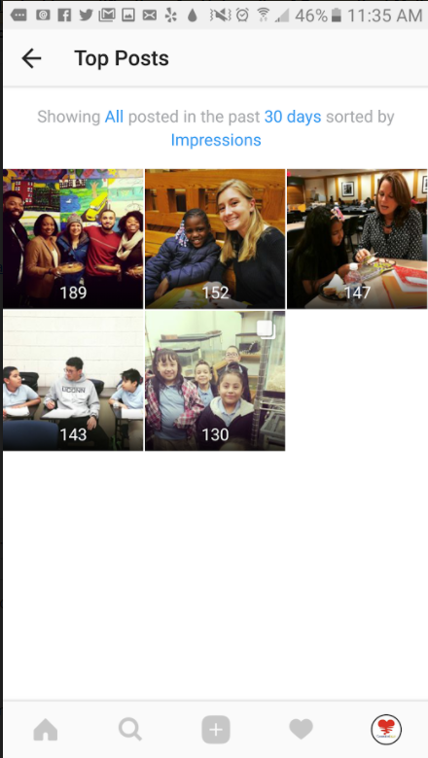

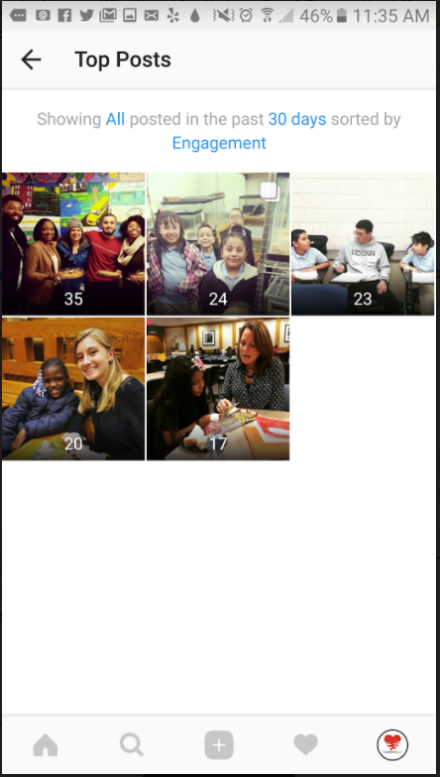
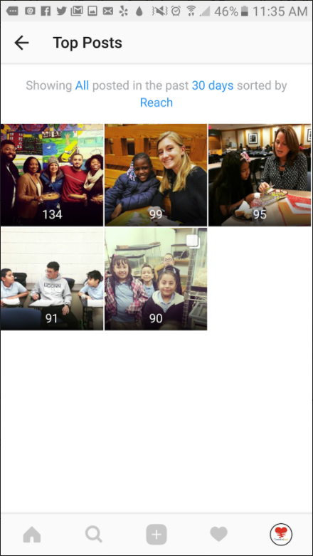
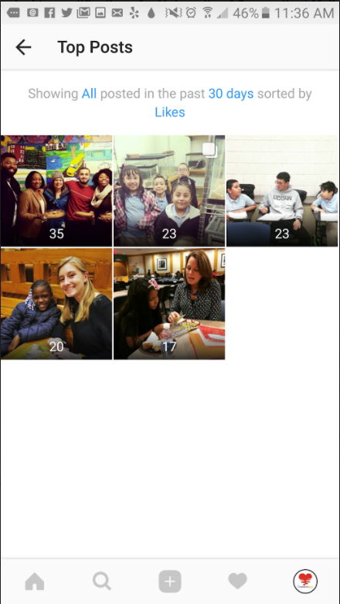

SOCIAL MEDIA OUTREACH-INSTAGRAM

Slide 14
FUTURE ROADMAP
Continue working on popularizing the social media touchpoints
Social Media Takeover for a day by a Mentor to share stories
Work on Search Engine Optimization specific to the Connecticut region
A more robust way of data collection about mentors to understand the gap and devise strategies accordingly
Have Webcasts about the mentoring program to understand user engagement
Sit and Draw competition for the Kids and auctioning the Top 5 photos

Slide 15


